Slide 1

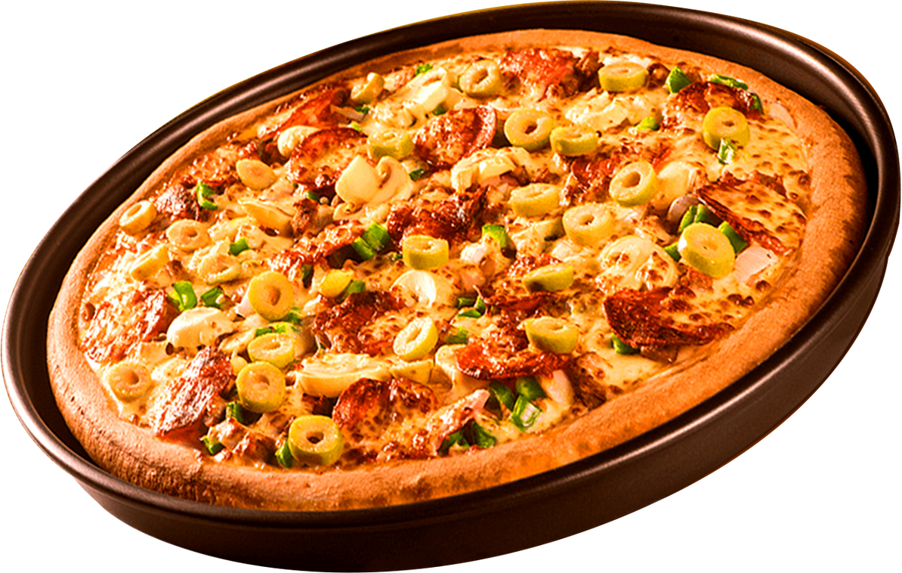


ELECTROSOFT
Home
About
Contact
PIZZA SALES DATA ANALYSIS INTERNSHIP PROJECT USING SQL
CREATED BY PRANAV PATEL(22CS060)

Slide 2


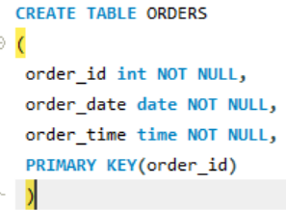
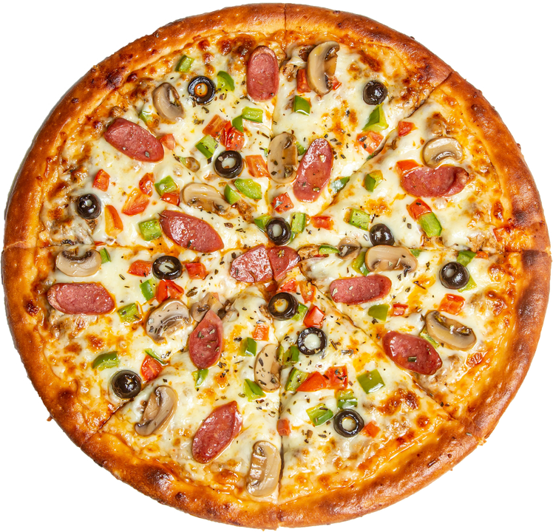
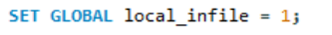
CREATING DATABASE,AND IMPORTING TABLES IN IT THROUGH IMPORT WIZARD AND CREATE TABLES,LOAD COMMAND
ELECTROSOFT
When you run
SET GLOBAL local_infile = 1;
it enables local_infile on the MySQL server process.
This setting stays ON until the server itself is restarted (like when you stop/start MySQL service, or reboot your PC).
So when you restart your server again you have to rerun this line.

Slide 3
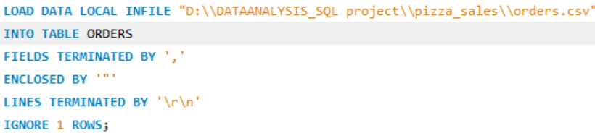
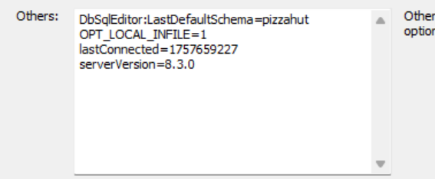
CREATING DATABASE,AND IMPORTING TABLES IN IT THROUGH IMPORT WIZARD AND CREATE TABLES,LOAD COMMAND
ELECTROSOFT
The ORDERS table had 21000 records.If we had done using IMPORT WIZARD then it would have taken long time to import.So, to import large files quickly in 5 to 10 seconds we use CRFEATE TABLES and LOAD DATA LOCA:L INFILE queries instead of TABLE IMPORT WIZARD.The rest of the tables pizza_types,pizzas have been imported directly thorugh import wizard as they were small
ALSO in SERVER advance settings include this too:
OPT_LOCAL_INFILE=1 to allow MYSQL Workbench access local files on your PC

Slide 4
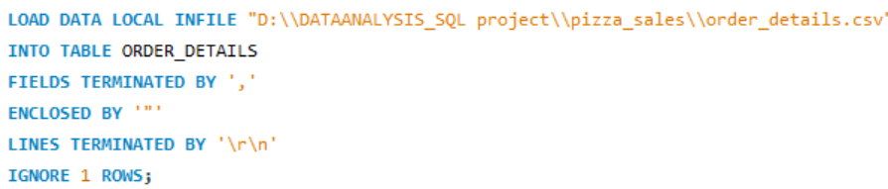
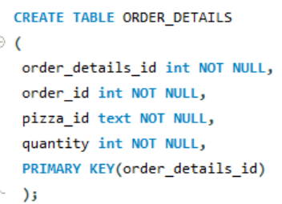
CREATING DATABASE,AND IMPORTING TABLES IN IT THROUGH IMPORT WIZARD AND CREATE TABLES,LOAD COMMAND
ELECTROSOFT
Do the same thing with ORDER_DETAILS as it has 48000 records

Slide 5
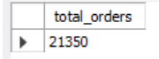

RETRIEVE THE TOTAL NUMBER OF ORDERS PLACED.
ELECTROSOFT

Slide 6
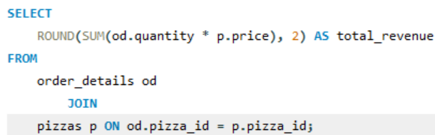
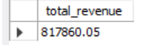
CALCULATE THE TOTAL REVENUE GENERATED FROM PIZZA SALES.
ELECTROSOFT

Slide 7
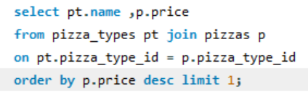
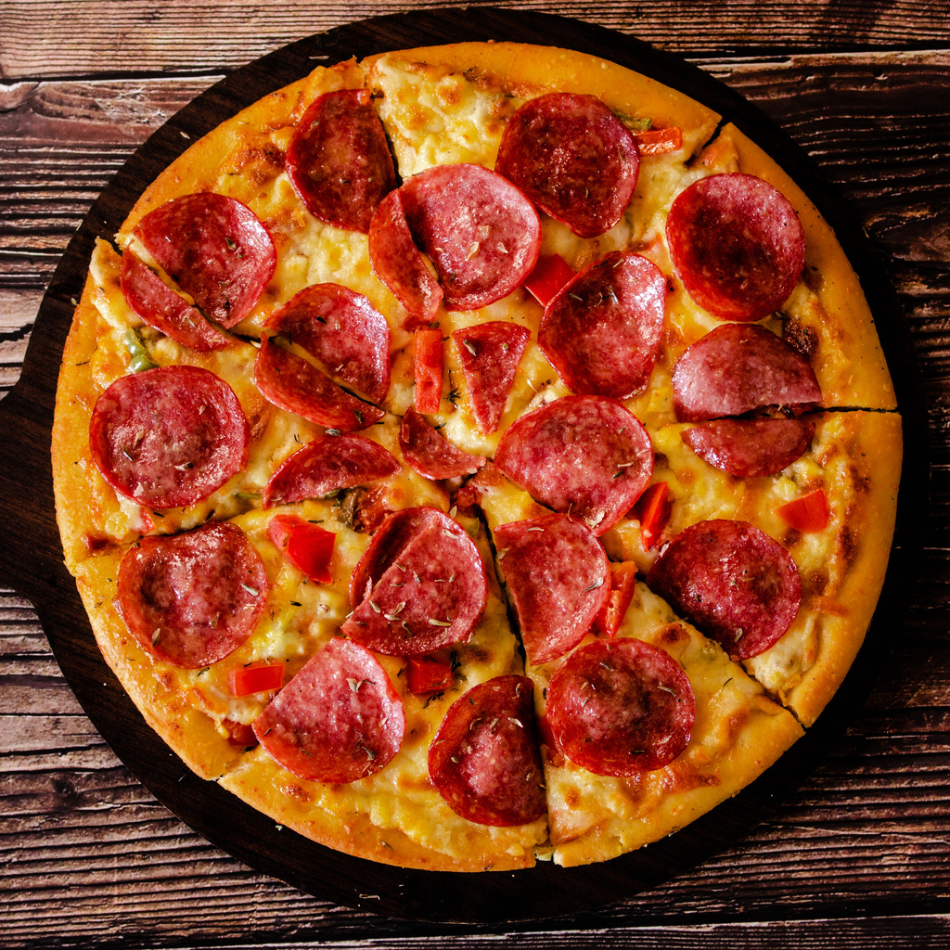
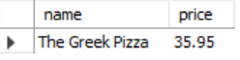
IDENTIFY THE HIGHEST-PRICED PIZZA.
ELECTROSOFT

Slide 8
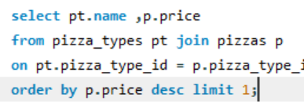
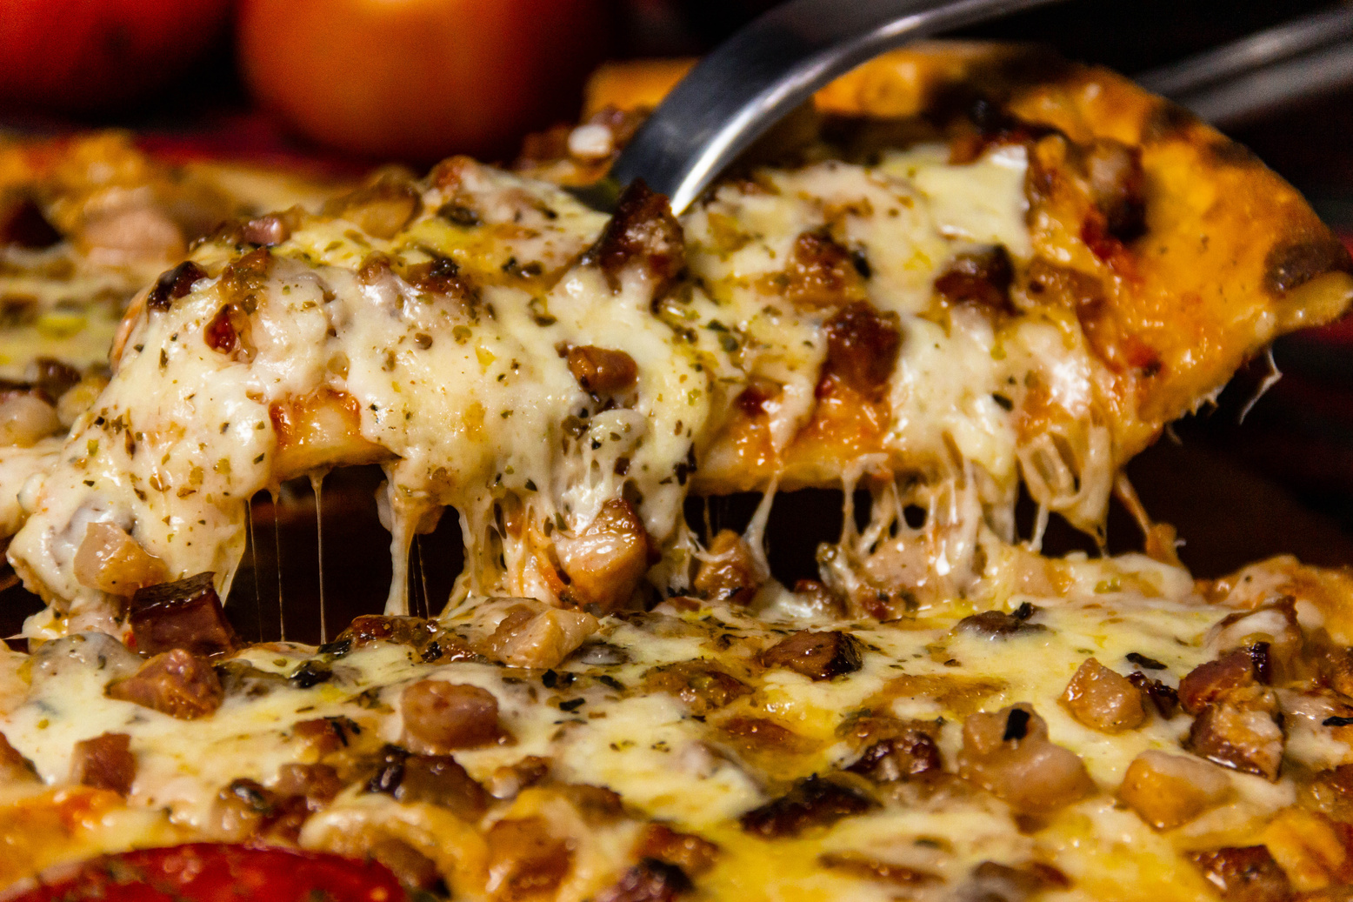
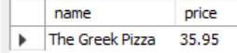
CALCULATE THE TOTAL REVENUE GENERATED FROM PIZZA SALES.
ELECTROSOFT

Slide 9
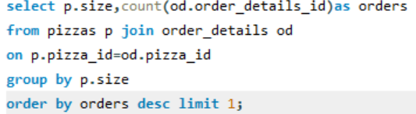
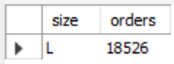
IDENTIFY THE MOST COMMON PIZZA SIZE ORDERED.
ELECTROSOFT

Slide 10
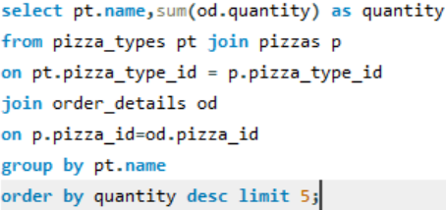
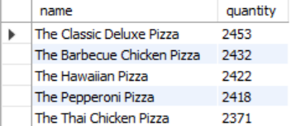
LIST THE TOP 5 MOST ORDERED PIZZA TYPES ALONG WITH THEIR QUANTITIES.
ELECTROSOFT
Here , we have done multiple joins between 3 tables.

Slide 11
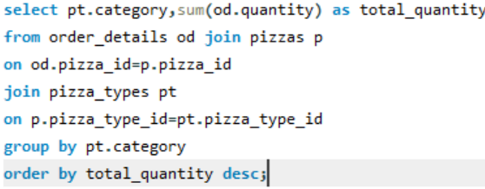
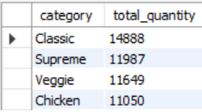
JOIN THE NECESSARY TABLES TO FIND THE TOTAL QUANTITY OF EACH PIZZA CATEGORY ORDERED.
ELECTROSOFT

Slide 12
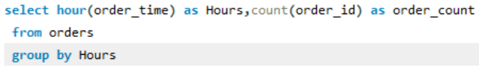
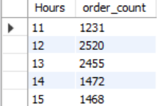
DETERMINE THE DISTRIBUTION OF ORDERS BY HOUR OF THE DAY.
ELECTROSOFT

Slide 13
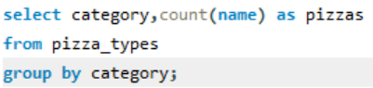
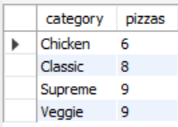
GROUP THE ORDERS BY DATE AND CALCULATE THE AVERAGE NUMBER OF PIZZAS ORDERED PER DAY.
ELECTROSOFT

Slide 14
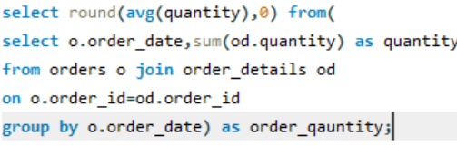
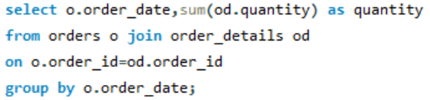
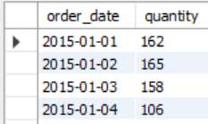
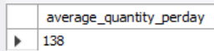
GROUP THE ORDERS BY DATE AND CALCULATE THE AVERAGE NUMBER OF PIZZAS ORDERED PER DAY.
ELECTROSOFT
Here,we used the concept of SUBQUERY.

Slide 15
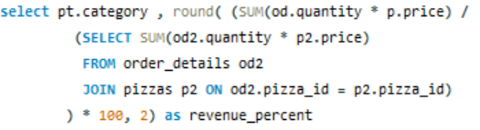
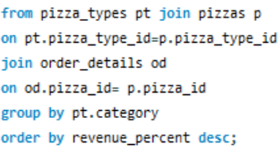
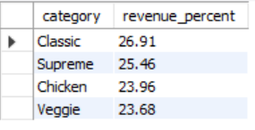
DETERMINE THE TOP 3 MOST ORDERED PIZZA TYPES BASED ON REVENUE.
ELECTROSOFT
We can’t write: round((sum(od.quantity*p.price)/sum(sum(od.quantity*p.price)))*100,2) as revenue_percent
🔴 Problem: you can’t nest SUM(SUM(...)). That’s invalid in SQL..

Slide 16
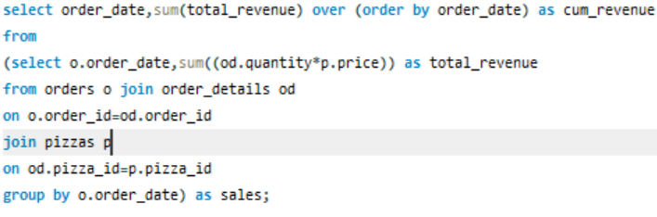
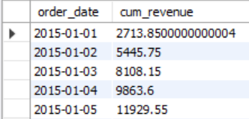
ANALYZE THE CUMULATIVE REVENUE GENERATED OVER TIME.
ELECTROSOFT
OVER is a WINDOW funnction.
A window function works row by row .
Normal aggregate (GROUP BY) → one output row per group.
Window function (OVER) → one output per row, but enriched with group-level / rank-level / running totals.

Slide 17
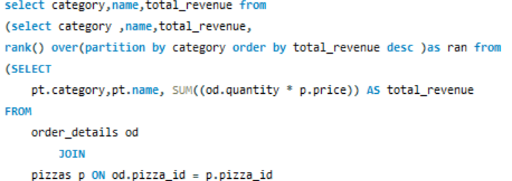
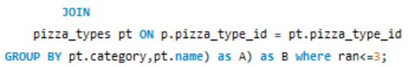
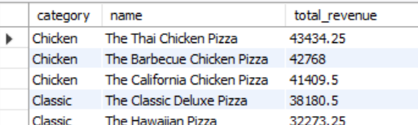
DETERMINE THE TOP 3 MOST ORDERED PIZZA TYPES BASED ON REVENUE FOR EACH PIZZA CATEGORY.
ELECTROSOFT
What it does:
rank() is a window function that assigns a rank to each row based on the ordering.
partition by category → reset the ranking separately within each category of pizzas.
order by revenue desc → higher revenue pizzas get smaller rank numbers (1 = highest revenue).
PARTITION BY (inside a window function like RANK() or SUM() OVER)
Think of it as "temporary grouping" for calculations.
SQL divides rows into smaller windows (partitions) based on a column value.
.

Slide 18
ELECTROSOFT
Home
About
Contact
THANK YOU

